Slide 1








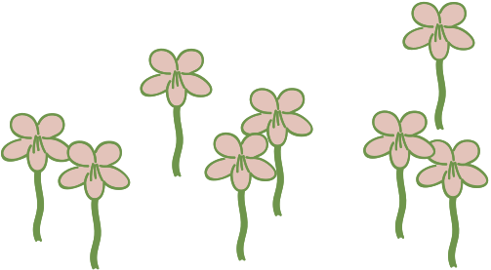

Wire Bonsai Tree Workshop
Spring 2025
We’ll be doing this upstairs on the third floor round tables!

Slide 2


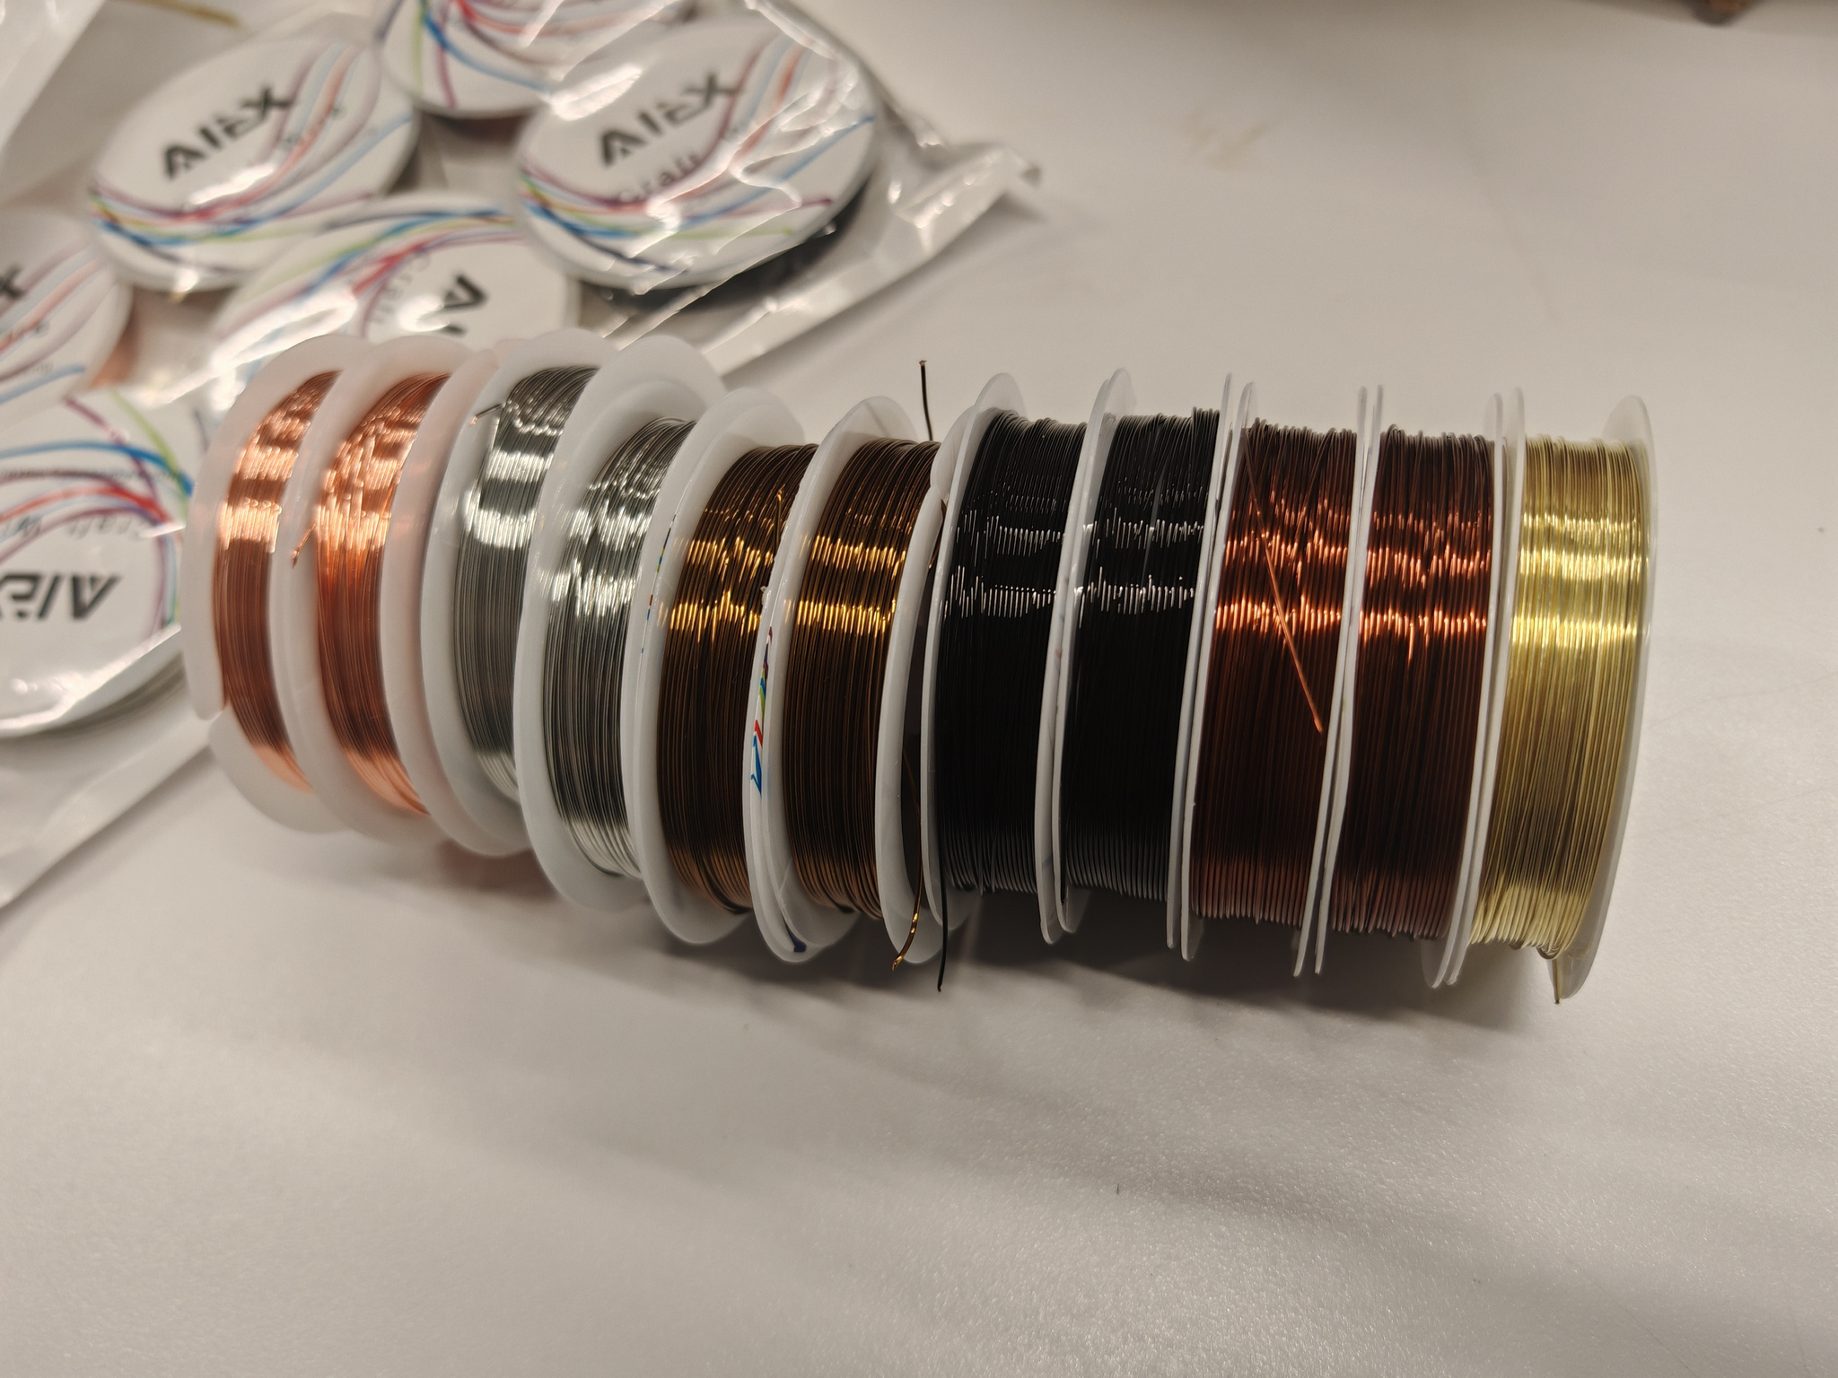


Gather your wire
A foot and a half (1 1/2) is a good starting point for the length of each wire
Use the wire cutters to cut the wire of your chosen colors
Steps
Choose a stone
We will be using stones as the base of the tree
Grab pliers
We have jewelry pliers to bend the branches to create your leaves

Slide 3
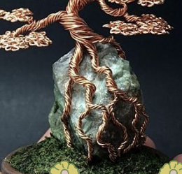
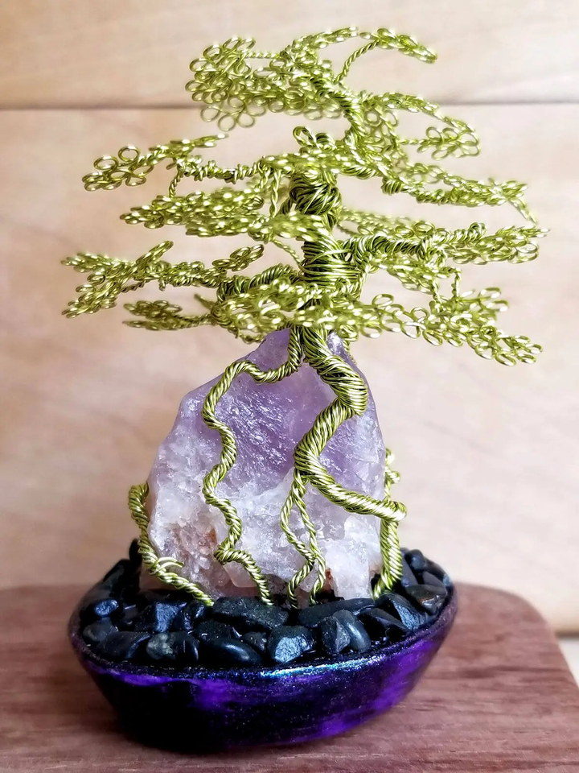
Wrapping around the base
For the base
You can use either a drill, or your hands to twist all the wires together about 4 inches from the bottom
Section the bottom of the wire underneath where you twisted it to be able to wrap around the stone
You can create multiple subsections as well for this part
Choose a flat part of the rock to be your base

Slide 4



# of wire = # of branches
Longer wire = fuller branches
It’s ok if the length of the initial wire is too long, you can cut them down as you go
Experiment with different methods of making your branches to start with
Rounded jewelry pliers are better for making loops
We also have needle nose if you prefer those
Have fun!
Tips

Slide 5


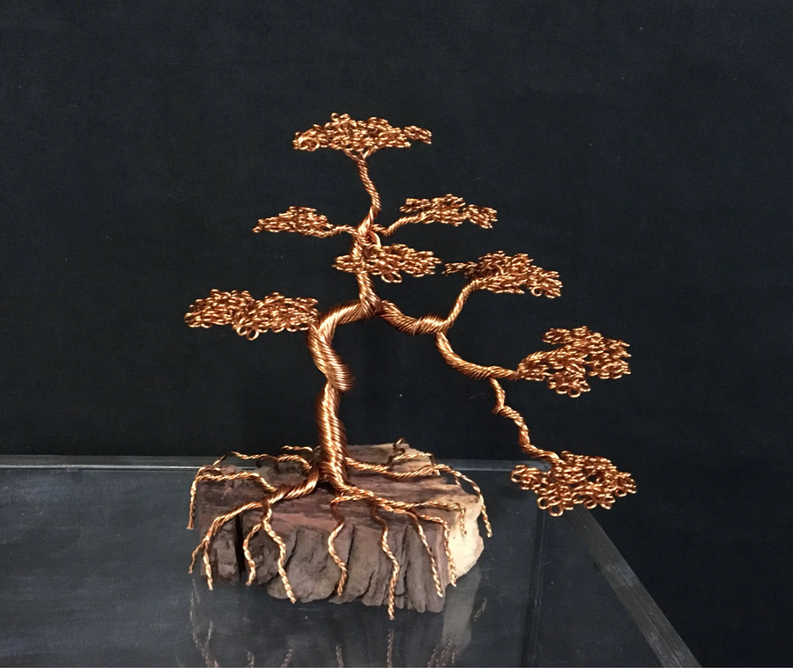

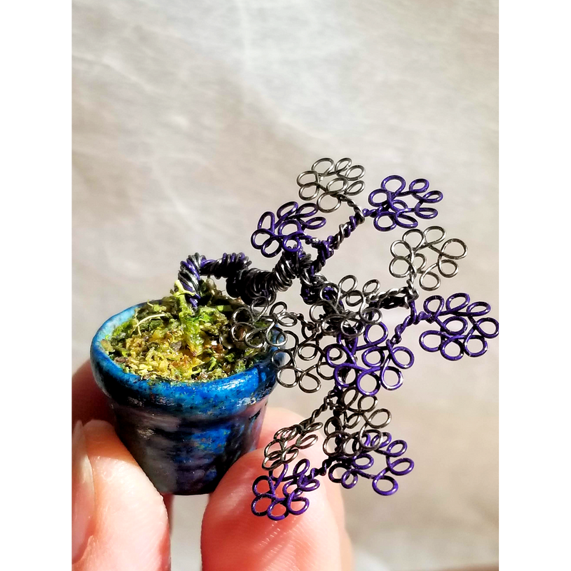
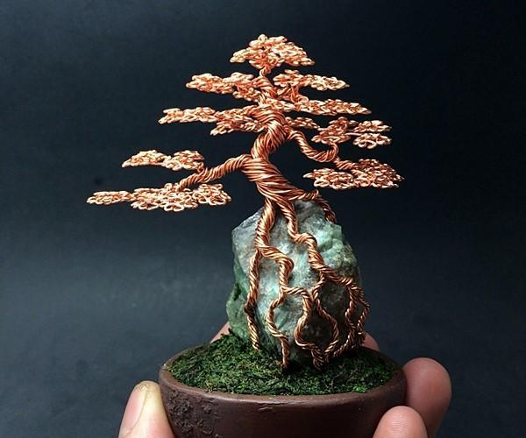

Inspiration Photos!

